Slide 1


Information Systems used in
Healthcare Industry
Group - M1
Ms. U.P.I. Ranchagoda - 20201009
Mr. M.A. Hussain - 20210935
Ms. H.M.U. Wijenayake - 20220001
Mr. D.E.P. Perera - 20220002
Mr. A.R.M. Rimaz - 20220003

Slide 2
Contents
Introduction to the Healthcare Industry
Importance/Role of information systems in the Healthcare Industry
Information systems used in the Healthcare Industry
3.1 EMR – Electronic Medical Record / EHR – Electronic Health Record
3.2 MPI – Master Patient Index
3.3 PMS – Practice Management Software
4. The Past, Present and the Future of Information Systems used in the Healthcare Industry
5. Summary

Slide 3

Introduction to the Healthcare Industry
Efforts made to maintain or restore physical, mental or emotional well being of people is defined as Healthcare .
Healthcare services are offered by specially trained and licensed professionals
This includes work done in providing
- Primary care
- Secondary care
- Tertiary care
- Public health

Slide 4
Importance of the Healthcare Industry
Healthcare industry is one of the largest and fastest growing industries in the world
Focused on the aspects of life that directly impact the lives of every human being
The healthcare industry also plays an important role as being the largest employer in the global economy

Slide 5
Importance of Health information systems
A health information system enables health care organizations to collect, store, manage, analyze, and optimize patient treatment histories and other key data.
Doctors use health information systems to make data-driven decisions. (onlinemasters,2020)
HIS enables the healthcare providers to easily get information about macro environments.
It is invaluable for administrators, who can analyze statistics on various topics. (onlinemasters,2020)

Slide 6
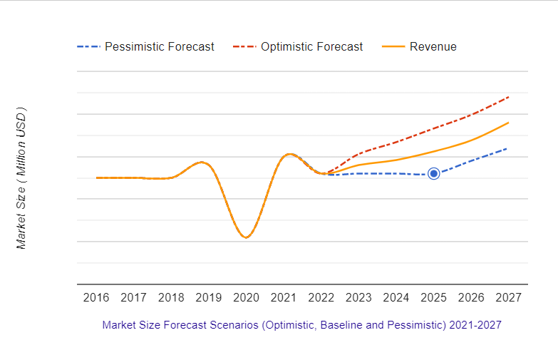
Market Size of health information systems
Brandessencereasearch.com states that “Healthcare Information System Market is valued at USD 282.70 Billion in 2021 and is expected to reach USD 579.56 Billion by 2028 with a CAGR of 10.8% over the forecast period.”
(Brandessencereasearch,2022)

Slide 7
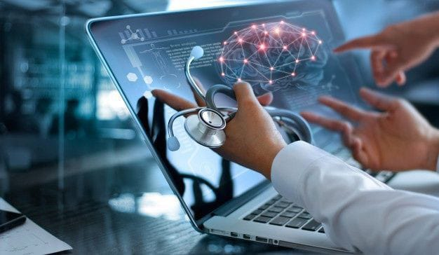
Role of Health Information Systems
HIS is about communication within various devices team members and patient medical .
Communication channels makes sure that hardware solutions are carefully selected and installed.
Healthcare IT standards provide a trustworthy system to the patient privacy rights and patient wellbeing.
Users are not embarrassed by awkward interfaces or unnecessary roadblocks .

Slide 8
Information SYSTEMS USED IN HEALTHCARE INDUSTRY
1.Electronic Medical Record (EMR) and Electronic Health Record (EHR)
Use workstations and servers, tablet PC, laptops, monitors, scanners, routers, and bridges.
Common features include digital charting, order entry, decision support, and clinical reporting.
Contains notes and information collected by and for the clinicians in that office, clinic, or hospital.
Programming an evaluation defines the needs and preferences of the organization to have in the EHR for the hospital to function planned into 1 or3 math’s.
Shares information with other health care providers and organizations.

Slide 9
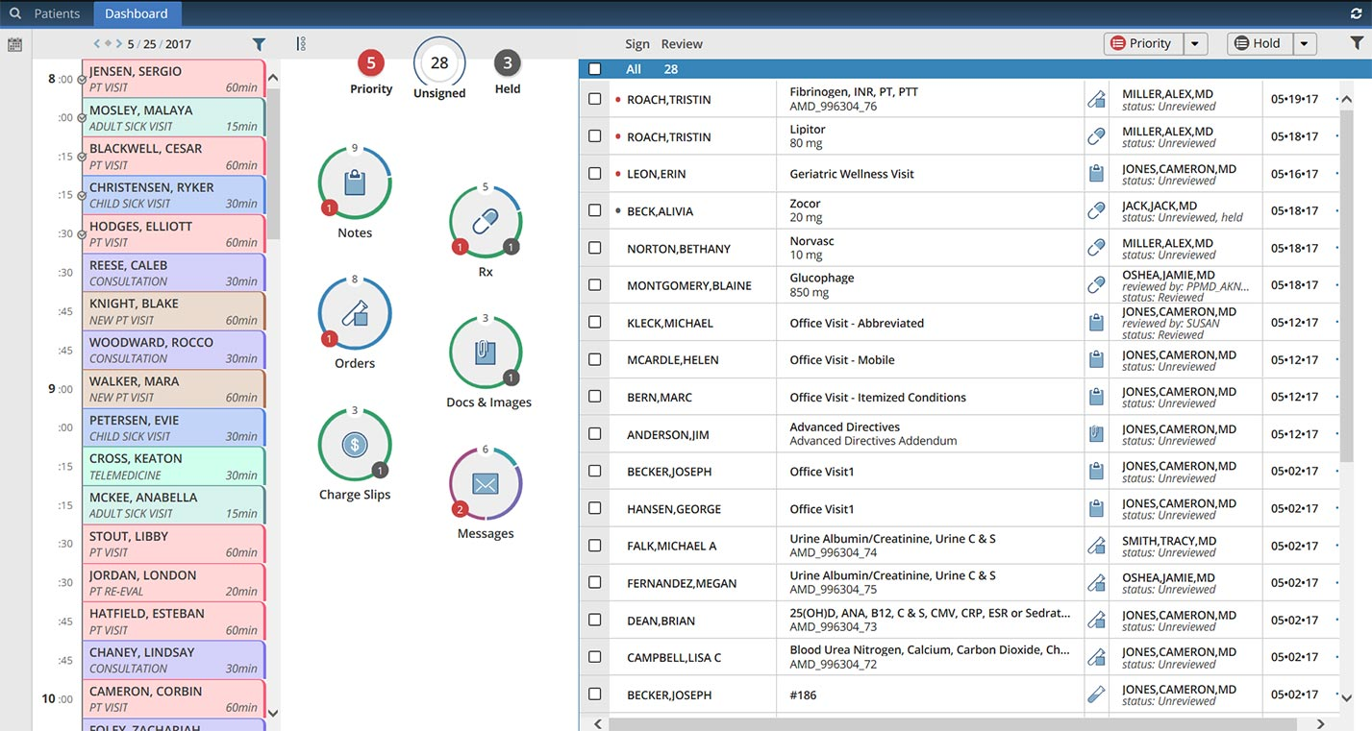
Figure Software used in EMR (advancedmd.com,)

Slide 10
2. Master Patient Index (MPI)
MPI uses PCs, servers etc. as hardware.
(EMPI) uses to maintain consistent and accurate information about each patient registered by a healthcare organization.
MPI data lists the medical record or identification number associated with the name.
Match individuals based on a combination of the following: Unique patient identifier, Patient name, Date of birth, Gender, Race, Ethnicity, Address, Alias/previous name, Biometrics such as fingerprints or face recognition, National identification number/passport number.
Patients who have been treated in an enterprise, doctors, physicians, nurses, staff etc. are people involved.

Slide 11

3. Practice Management Software
Requires just an internet connection and a simple computer network.
Manages the day-to-day operations of a clinic (Kareo)
It can be deployed three different ways: as desktop-only software, client-server software or Internet-based software.
Encompasses multiple topics including governance, the financial aspects of medical billing, staff management, ancillary service development, information technology, transcription utilization, and marketing.
Functions performed in practice management software are;
-Preregister patients.
-Establish financial responsibility.
-Check in patients.
-Check out patients.
Involves training, directing, and motivating team members.

Slide 12
Evaluation of Information System in Healthcare industry from past to present
Past -A historical analysis shows major milestones of the development of global medical informatics and Health Information Systems: during the 1960s
Present
  What is Big Data in Healthcare industry?
  Telehealth, How to use it?
  Communication systems in Healthcare industry.
  App development in Healthcare.

Slide 13
Artificial Intelligence
future OF health INFORMATION SYSTEMS
Atom wise uses its AI technology to root out therapies from a database of molecular structures.
Google’s deep mind making an AI for analyze bone cancer.
Managing using AI is the best option compared with human management.

Slide 14

Nano Technology
Nanobots bots can easily swim through body fluids
collect in-depth data on the human brain
Sensors powered by magnetic nanoparticles

Slide 15
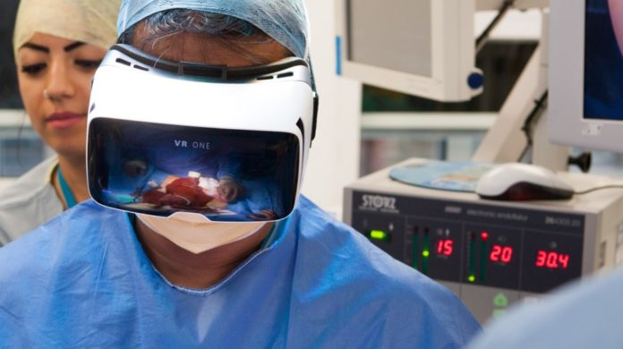
VR-VIRTUAL REALITY
In brief we can say VR as virtual reality
Mainly VR can be used to train surgeons for their operations.
Pain management using VR
Osso VR and Immersive Touch companies are the big names behind those

Slide 16
SUMMARY
Healthcare industry is one of the largest and fastest growing industries in the world.
This includes work done in providing,
-Primary care
-Secondary care
-Tertiary care
-Public health
Information systems used in the healthcare industry makes sure that all healthcare providers gets trends easily in order to be updated.
HIS is about communication within various devices, team members and patient medical.
EMR, MPI and Practice management sw are some of the information systems used in the healthcare industry.
Healthcare information systems have been evolved exponentially over time.
Although, there isn't much information to be found on the information systems used in the past, telehealth and EHR are Information systems used presently.
Al and VR are some of the health information systems developed to use in the future.

Slide 17

THANK YOU!

